Slide 1
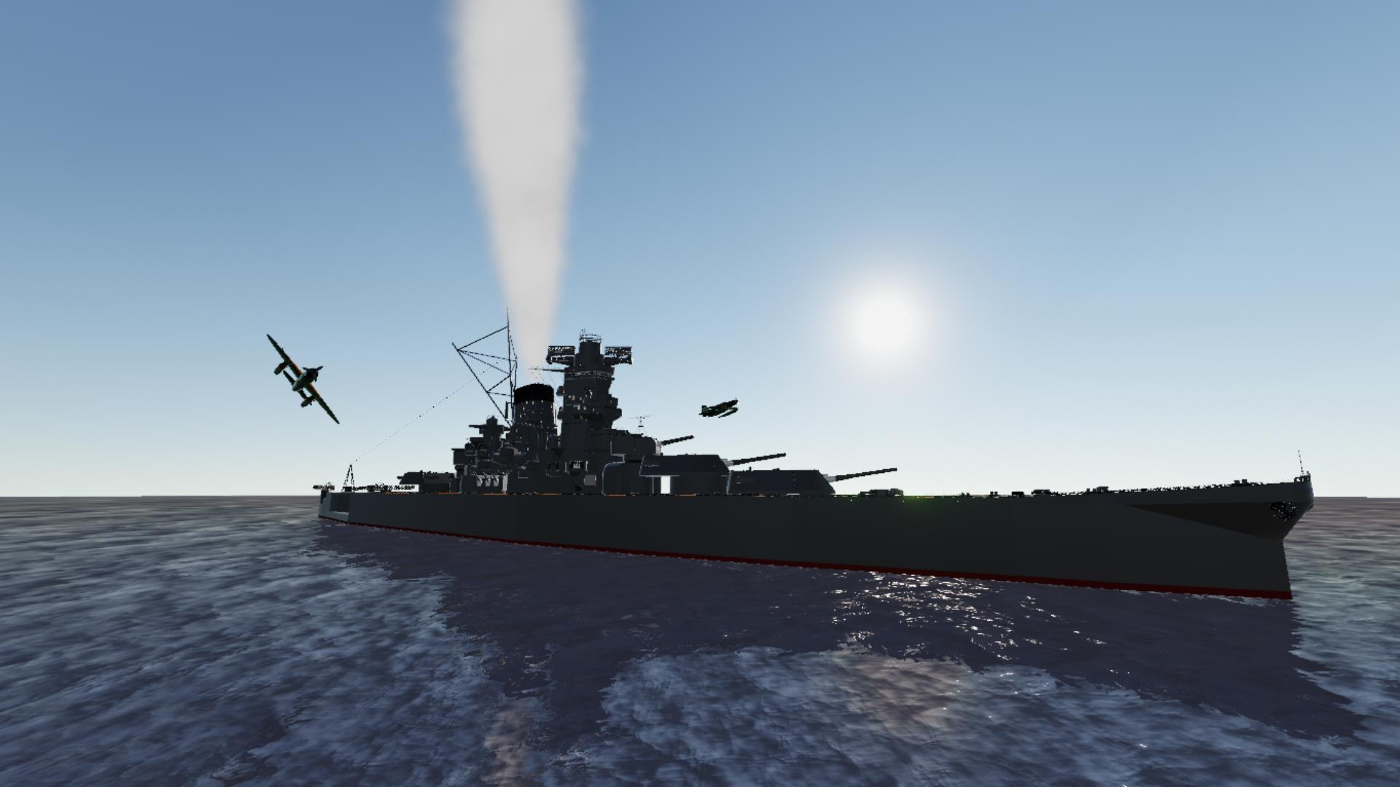

Project 1:
Battleship game
Eric x Ting

Slide 2
Project description:
Background:
to apply what we have learnt in week 1 and create a game with Python
The game - Battleship:
2 players with 5 ships placed on a 10x10 grid, each taking turns to attack the opponent’s ship in the hope of sinking all. The first one with no remaining ships in the end loses.

Slide 3
The process flow:
Defining the tasks to be done
Draw the flowchart of the algorithm
Actual coding
Presentation preparation

Slide 4
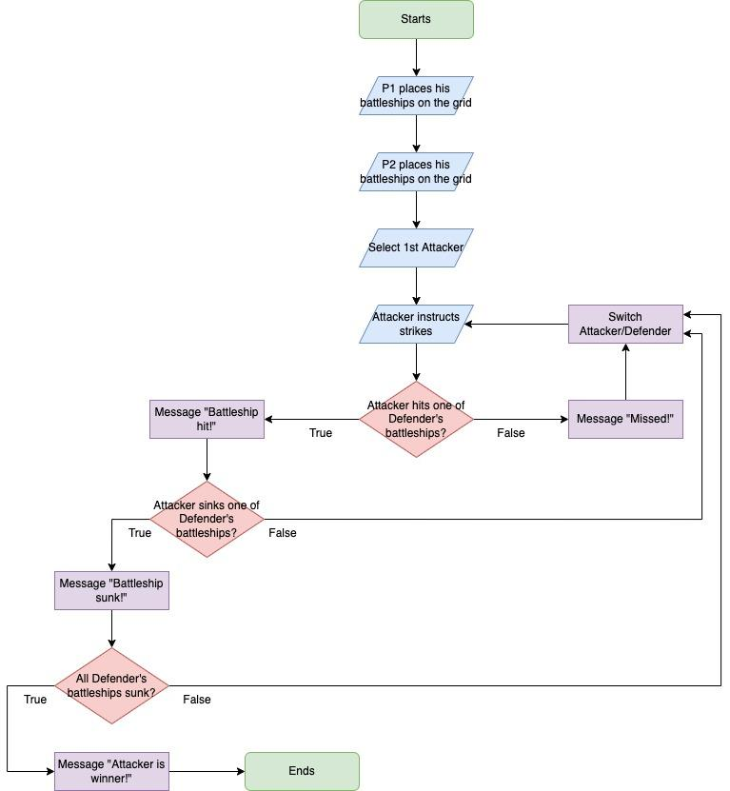
Logic
behind
the
codes:

Slide 5
Challenges encountered:
Tight schedule
Complex conditions involving 2 players
Converting int to A-Z on a grid
Not enough coding logic thinking (Ting)
Object oriented programming
Continuous improvement never stops

Slide 6
Demo time!

Slide 7
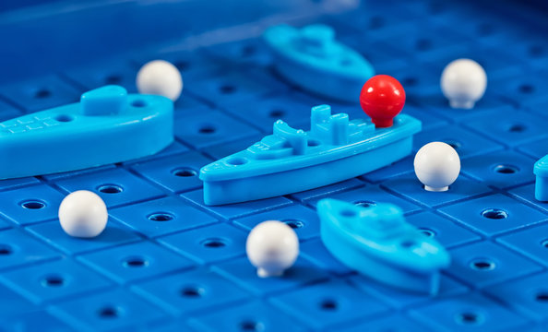
Thank you

